Slide 1
Health Management System for Dairy Cattle
Members
Akash, Chinmay, Utkarsha, Pooja
Business Analyst
Date : 18th Feb 2026

Slide 2
Business Problem Statement
Dairy farms rely on manual and fragmented health record-keeping methods
Health information is often recorded informally or not documented consistently
Delayed identification of illness affects cattle productivity and farm efficiency
Treatment history is difficult to track and retrieve
Limited coordination between dairy farmers and veterinarians

Slide 3
Project Objective
Develop a structured framework for managing cattle health records
Standardize documentation of symptoms, treatments, and consultations
Improve coordination between dairy farmers and veterinarians
Enhance visibility of cattle health history for informed decision-making
Deliver comprehensive Business Analysis artifacts and UML models

Slide 4
Scope of the Project
Creation and management of cattle profiles
Recording and tracking of health conditions
Documentation of treatments and follow-ups
Scheduling and recording veterinary visits
Role-based user access

Slide 5
Key Stakeholders
👨‍🌾 Dairy Farmer
Records health conditions
Schedules veterinary visits
Monitors treatment history
👩‍⚕️ Veterinarian
Conducts consultations
Records diagnosis and treatment
Documents follow-up instructions
👤 System Administrator
Manages user accounts
Assigns roles and access permissions

Slide 6
Current State vs Future State
🔴 Current State (As-Is)
Manual or fragmented record-keeping
Health data stored in notebooks or memory
Delayed detection of illness
Inconsistent treatment tracking
Limited visibility of historical health data
🟢 Future State (To-Be)
Centralized cattle health profiles
Structured documentation of symptoms and treatments
Systematic scheduling of veterinary visits
Organized treatment and follow-up tracking
Improved visibility for informed decision-making

Slide 7
Key Business Requirements
Establish centralized cattle health record management
Standardize documentation of symptoms, treatments, and consultations
Enable structured scheduling and tracking of veterinary visits
Maintain historical health and treatment information
Improve operational visibility and coordination between stakeholders

Slide 8
System Capabilities (Functional Overview)
Create and manage individual cattle profiles
Record and update health conditions
Schedule and document veterinary visits
Record treatment details and follow-up instructions
View complete health and treatment history

Slide 9
Non-Functional Requirements
🔐 Security
Role-based access control
Restricted access to authorized users
🖥 Usability
Simple and intuitive interface for non-technical users
Minimal steps for recording health information
🌐 Accessibility
Web-based system access
Available through standard browsers
⏱ Availability
Accessible during farm operating hours

Slide 10
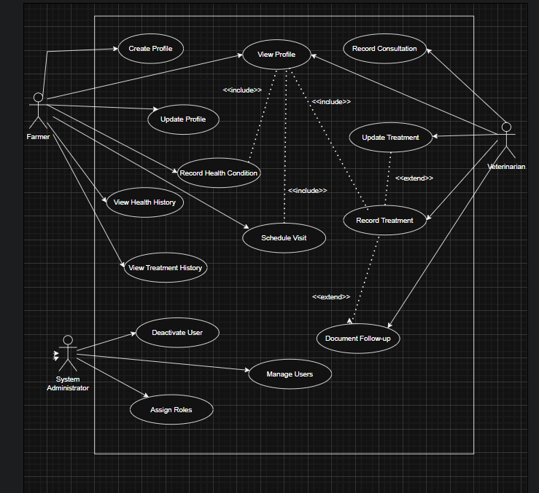
UseCase Diagram

Slide 11
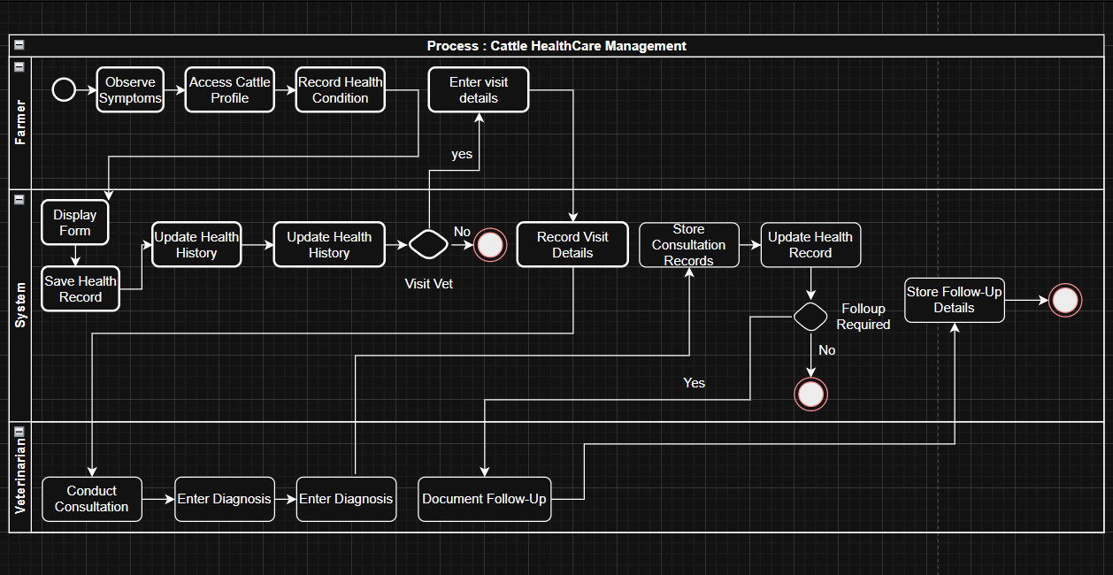
Swimlane Diagram

Slide 12
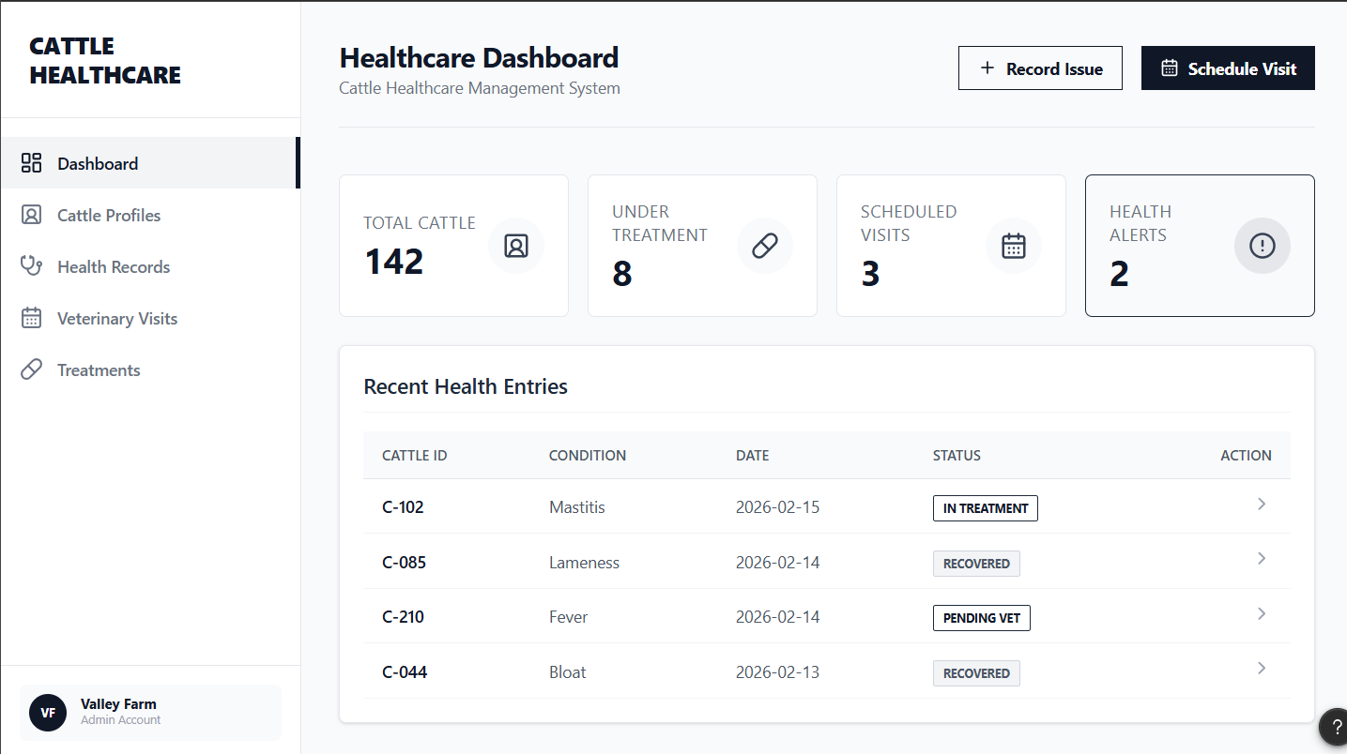
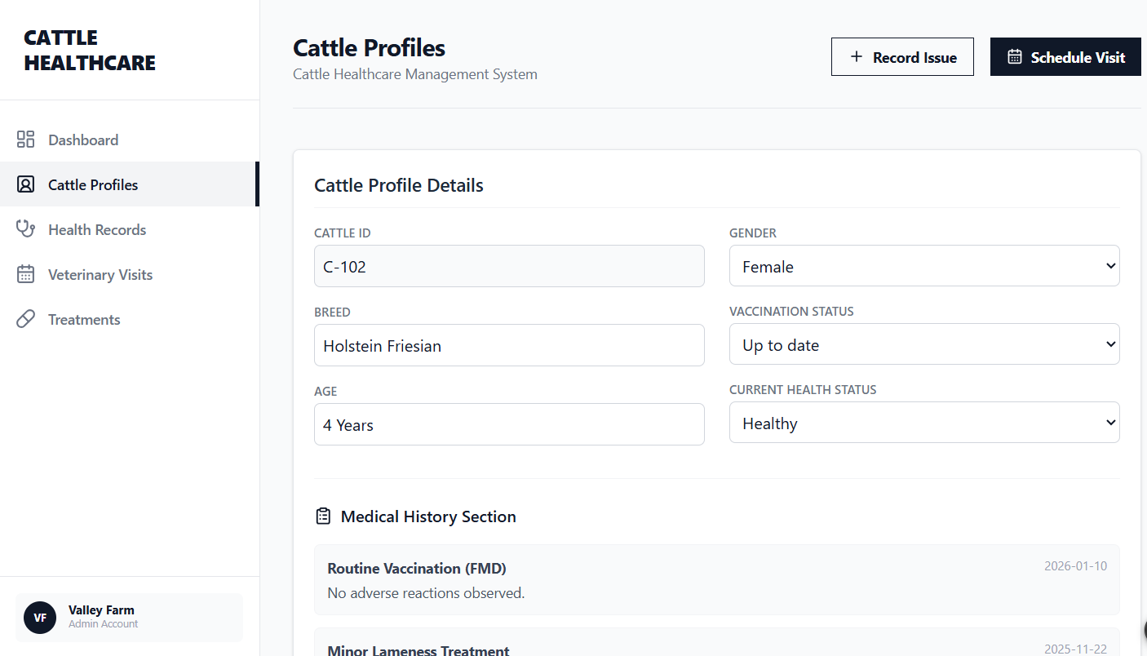
Prototype

